Slide 1
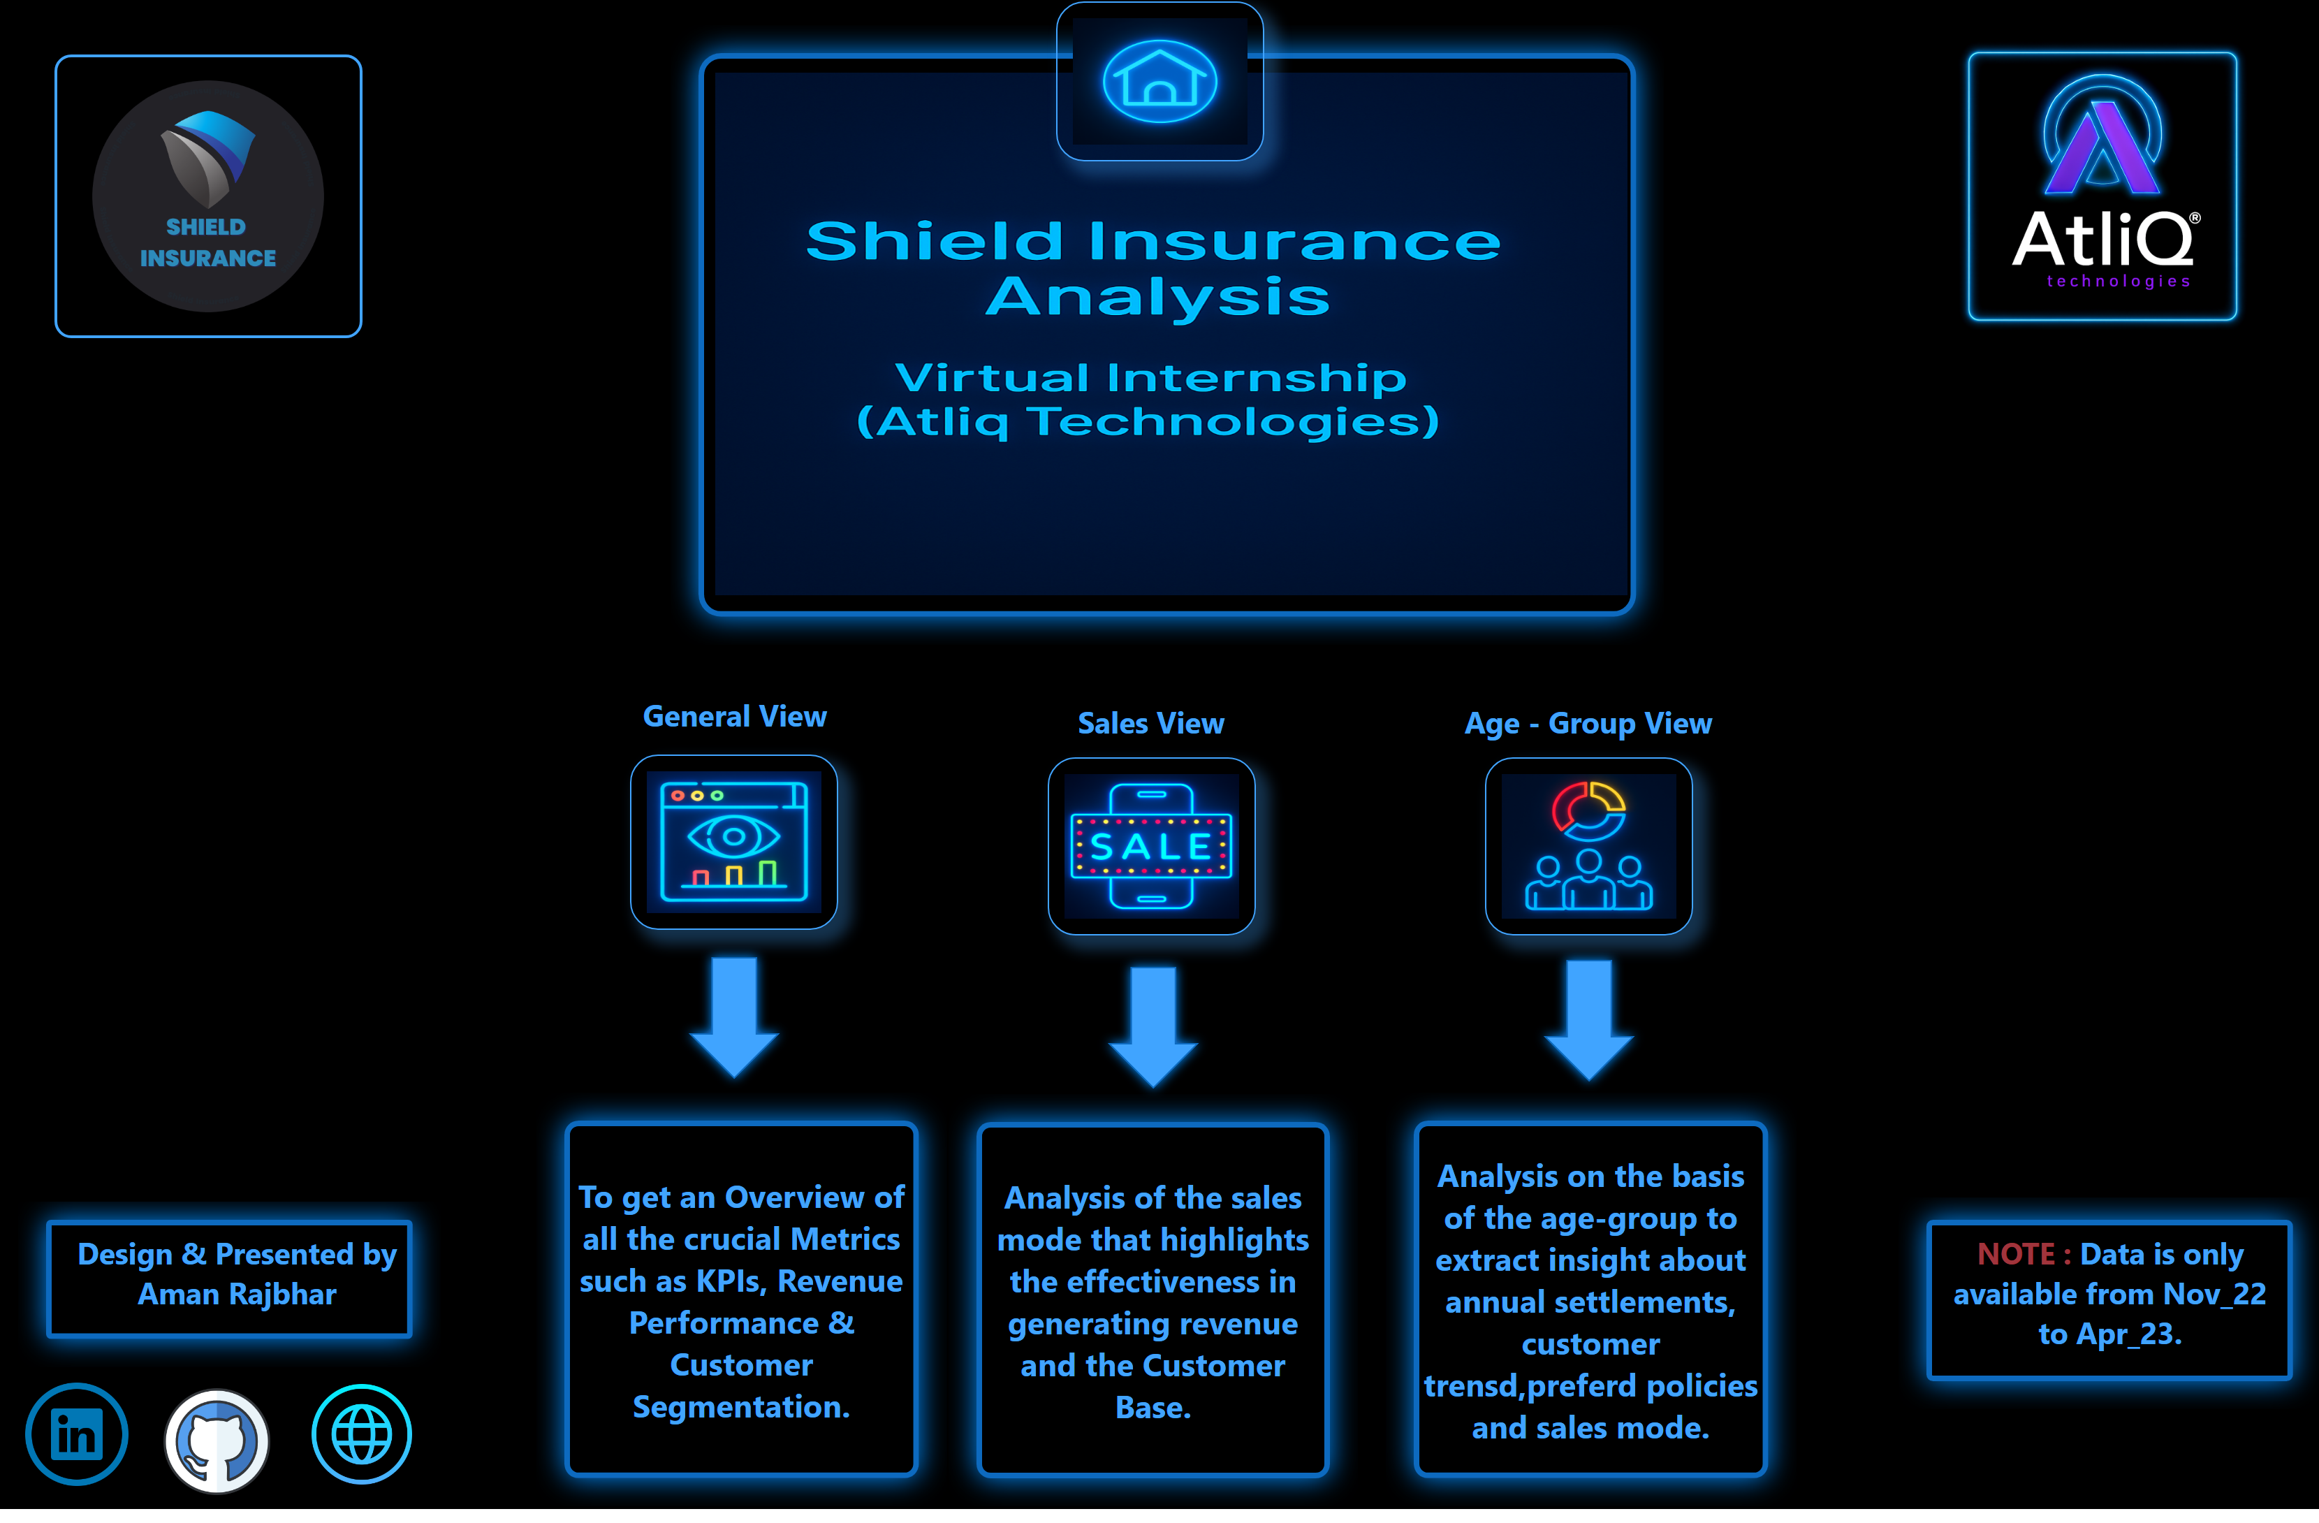
Home
Notes:
shape
No alt text provided
image
No alt text provided
image
No alt text provided
image
No alt text provided
image
No alt text provided
image
No alt text provided
image
No alt text provided
shape
No alt text provided
shape
No alt text provided
shape
No alt text provided
shape
No alt text provided
shape
No alt text provided
shape
No alt text provided
textbox
No alt text provided
textbox
No alt text provided
textbox
No alt text provided
textbox
No alt text provided
shape
No alt text provided
image
No alt text provided
image
No alt text provided
image
No alt text provided
image
No alt text provided
shape
No alt text provided
textbox
No alt text provided

Slide 2
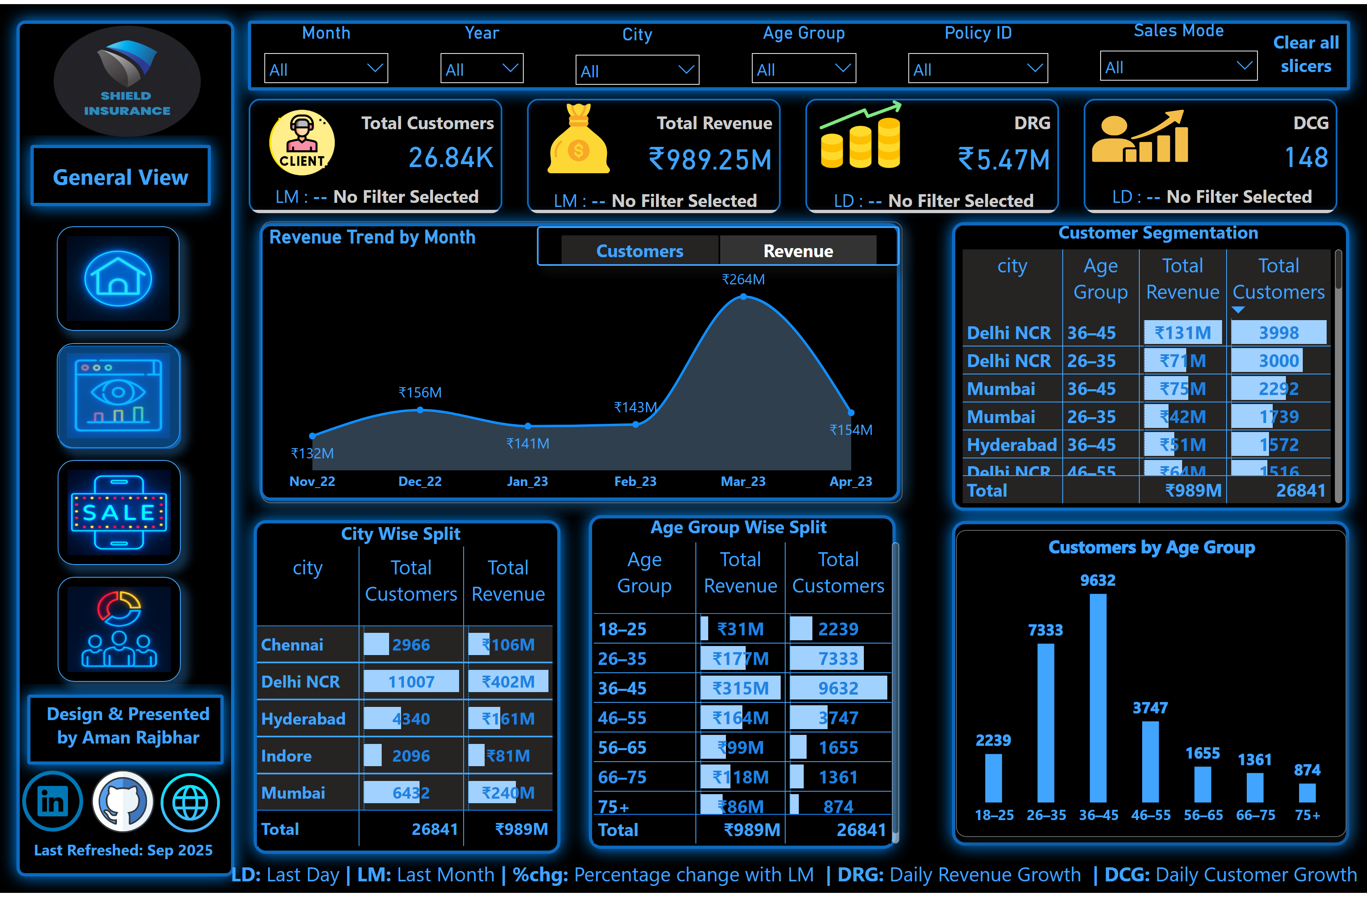
General View
Notes:
textbox
No alt text provided
Customers by Age Group
No alt text provided
tableEx
No alt text provided
textbox
No alt text provided
image
No alt text provided
image
No alt text provided
image
No alt text provided
image
No alt text provided
Month
No alt text provided
Year
No alt text provided
City
No alt text provided
Age Group
No alt text provided
Policy ID
No alt text provided
Sales Mode
No alt text provided
shape
No alt text provided
image
No alt text provided
image
No alt text provided
image
No alt text provided
textbox
No alt text provided
shape
No alt text provided
actionButton
No alt text provided
image
No alt text provided
image
No alt text provided
image
No alt text provided
image
No alt text provided
shape
No alt text provided
shape
No alt text provided
shape
No alt text provided
shape
No alt text provided
shape
No alt text provided
shape
No alt text provided
shape
No alt text provided
shape
No alt text provided
shape
No alt text provided
textbox
No alt text provided
image
No alt text provided
tableEx
No alt text provided
Revenue by City & Age Group
No alt text provided
textbox
No alt text provided
Revenue Trend by Month
No alt text provided
slicer
No alt text provided
cardVisual
No alt text provided

Slide 3
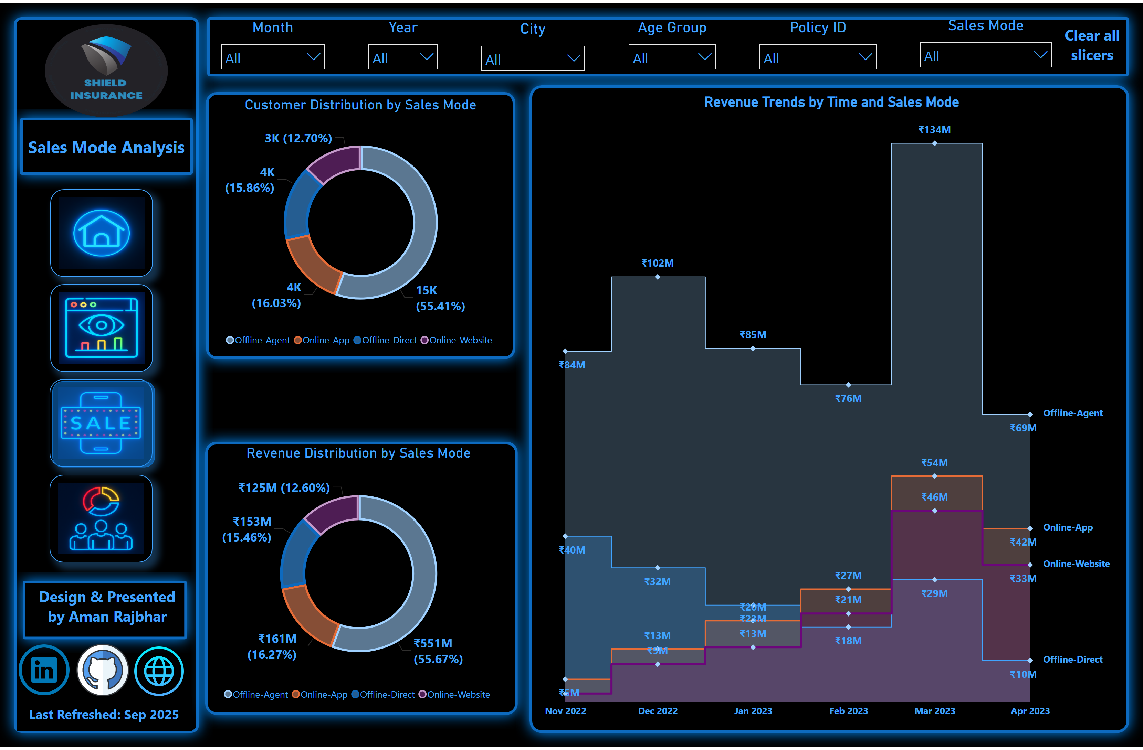
Sales View
Notes:
Customer Distribution by Sales Mode
No alt text provided
Revenue Distribution by Sales Mode
No alt text provided
Revenue Trends by Time and Sales Mode
No alt text provided
image
No alt text provided
shape
No alt text provided
image
No alt text provided
image
No alt text provided
image
No alt text provided
image
No alt text provided
actionButton
No alt text provided
shape
No alt text provided
shape
No alt text provided
shape
No alt text provided
shape
No alt text provided
shape
No alt text provided
shape
No alt text provided
textbox
No alt text provided
shape
No alt text provided
image
No alt text provided
image
No alt text provided
image
No alt text provided
Month
No alt text provided
Year
No alt text provided
City
No alt text provided
Age Group
No alt text provided
Policy ID
No alt text provided
Sales Mode
No alt text provided
shape
No alt text provided

Slide 4
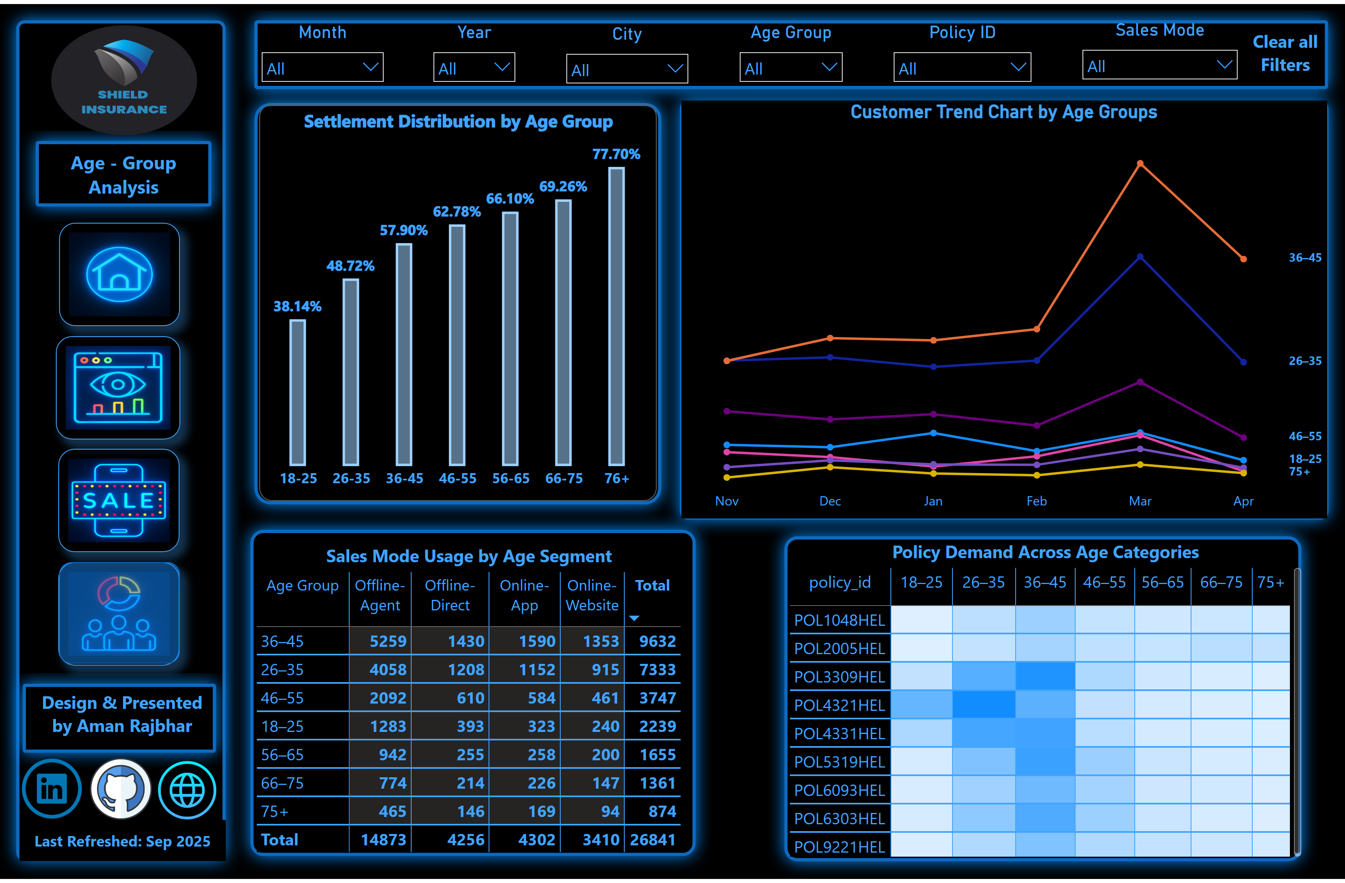
Age-group View
Notes:
pivotTable
No alt text provided
Settlement Distribution by Age Group
No alt text provided
pivotTable
No alt text provided
Customer Trend Chart by Age Groups
No alt text provided
image
No alt text provided
shape
No alt text provided
image
No alt text provided
image
No alt text provided
image
No alt text provided
image
No alt text provided
actionButton
No alt text provided
Sales Mode
No alt text provided
Policy ID
No alt text provided
Age Group
No alt text provided
City
No alt text provided
Month
No alt text provided
shape
No alt text provided
textbox
No alt text provided
textbox
No alt text provided
shape
No alt text provided
shape
No alt text provided
shape
No alt text provided
shape
No alt text provided
shape
No alt text provided
textbox
No alt text provided
shape
No alt text provided
shape
No alt text provided
image
No alt text provided
image
No alt text provided
image
No alt text provided
Year
No alt text provided
shape
No alt text provided

